Slide 1
Project Structure
Module 12 – RPA Fundamentals

Slide 2
RPA Fundamentals Module 12 contents
Workflows
Configuration Files

Slide 3
Workflows
RPA Fundamentals – Module 12: Project Structure

Slide 4
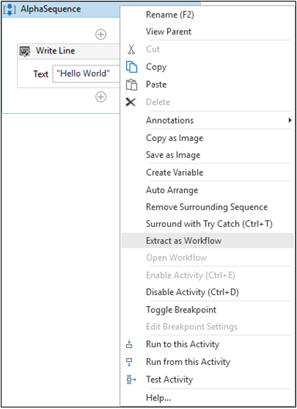
Invoke Workflow
UiPath works towards 4 principles during a project; reliability, efficiency, maintainability and extensibility
This is enhanced through a sound project structure
The Invoke Workflow activity helps with this by joining independent workflows together
Keeps workflow clean and maintainable
Sequences can be extracted as discreet extracted Workflows

Slide 5
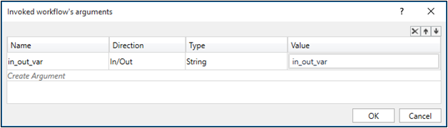
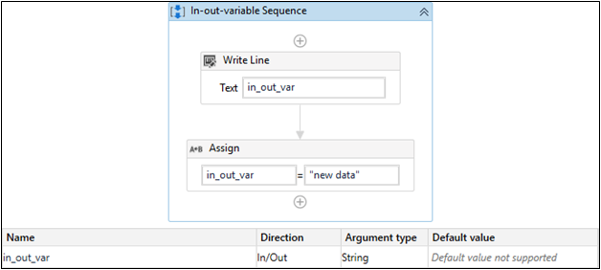
Passing Arguments in and out
Clicking Import Arguments will show the Argument Name (defaults to variable name) and its value
The value will be that of the Variable created in the Main Flowchart
The Direction is set to In, as the value needs to be passed in to the workflow

Slide 6
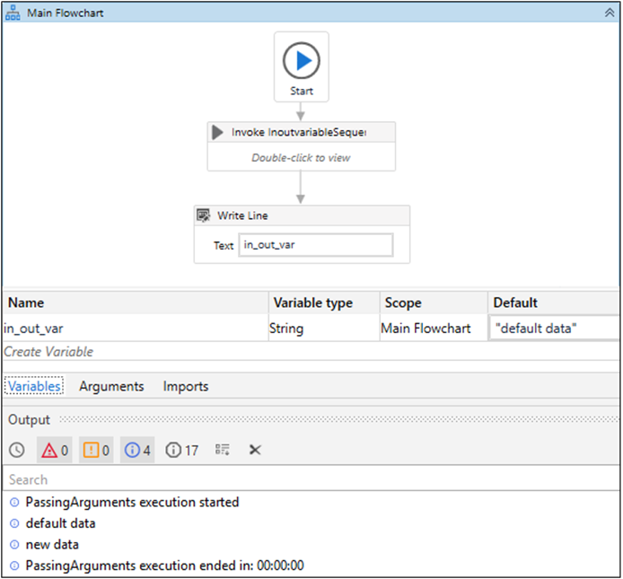
Final workflow
Invoked sequence
Workflow arguments that are passed in as variables
Execution of the flow provides the following output; the value new data will come from the invoked sequence that takes the in_out_var argument and changes it locally

Slide 7
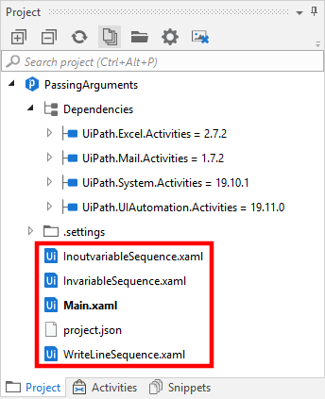
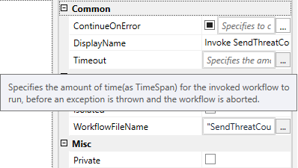
Project Structure Pane
The Project structure pane shows the extracted workflows
There’s a Timeout Property for the Invoke Workflow activity
This will throw an exception if the entire workflow within the Invoke activity isn’t completed within the Timeout period

Slide 8
Configuration Files
RPA Fundamentals – Module 12: Project Structure

Slide 9
What is JSON?
JavaScript Object Notation (or JSON) is a lightweight format for sending and storing data
Often used when data is sent from a server to a web page
Also used to store content in an easily maintained way
Some general JSON syntax rules:
Data is written in name/value pairs
Data is separated by commas
Curly braces {} hold objects
Square brackets [] hold arrays

Slide 10
Square brackets indicate an array of objects – not required if there’s only one JSON object
Curly brackets indicate the start/end of a JSON object
JSON Example
[
{
"name": "Chester",
"role": "RPA tech trainer",
"location": "Manchester"
},
{
"name": "Chris L",
"role": "RPA tech lead",
"location": "Manchester"
}
]
JSON objects are constructed of name/value pairs

Slide 11
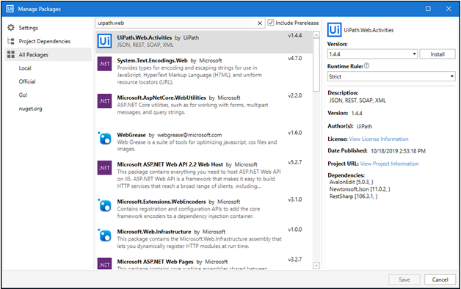
The Use of Config Files and JSON
We should get into the practice of storing configuration details in an external source
Typically done in a structured .txt file
Recommended to write in JSON – UiPath has a Deserialize JSON Activity after installing the UiPath.Web.Activities package
The Deserialize JSON Activity can be used to create an object of the configuration values
This can be assigned to specific variables with an Assign Activity
We read the .txt file with a Read Text File Activity

Slide 12
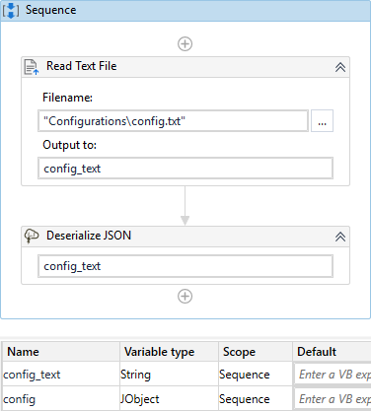
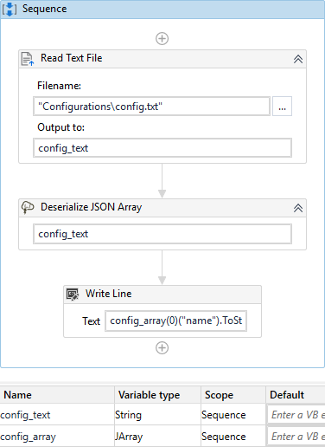

JSON is a data serialization language, which means it translates complex file and data structures into a simple format that can be sent, stored and reconstructed
Data Deserialization is the inverse of this – translating the simple format into a usable format for an application
There are 2 activities of deserialization within UiPath – Deserialize JSON and Deserialize JSON Array
Deserializing JSON in UiPath

Slide 13
Accessing the JSON data
For JSON Objects (not an array)
Pass values to the Deserialize JSON Activity
TypeArgument must be JObject
Elements within file can be accessed by: JsonOutputVariable(“key name”).ToString
For JSON Array objects
Pass values to the Deserialize JSON Array Activity
TypeArgument must be JArray
Elements within file can be accessed by: JsonOutputVariable(index)(“key name”).ToString

Slide 14
summary
UiPath uses a project structure to ensure for good application building practices
Invoking workflows is a good technique to implement for this
These workflows take in arguments and produce outputs for the larger context of a project if needed
For arguments and variables, we should use a config file
This is typically a JSON file with variables stored as name/values
We can then deserialize them with UiPath activities
RPA Fundamentals – module 12

Slide 15
Thank you for listening
Any questions?

